Slide 1
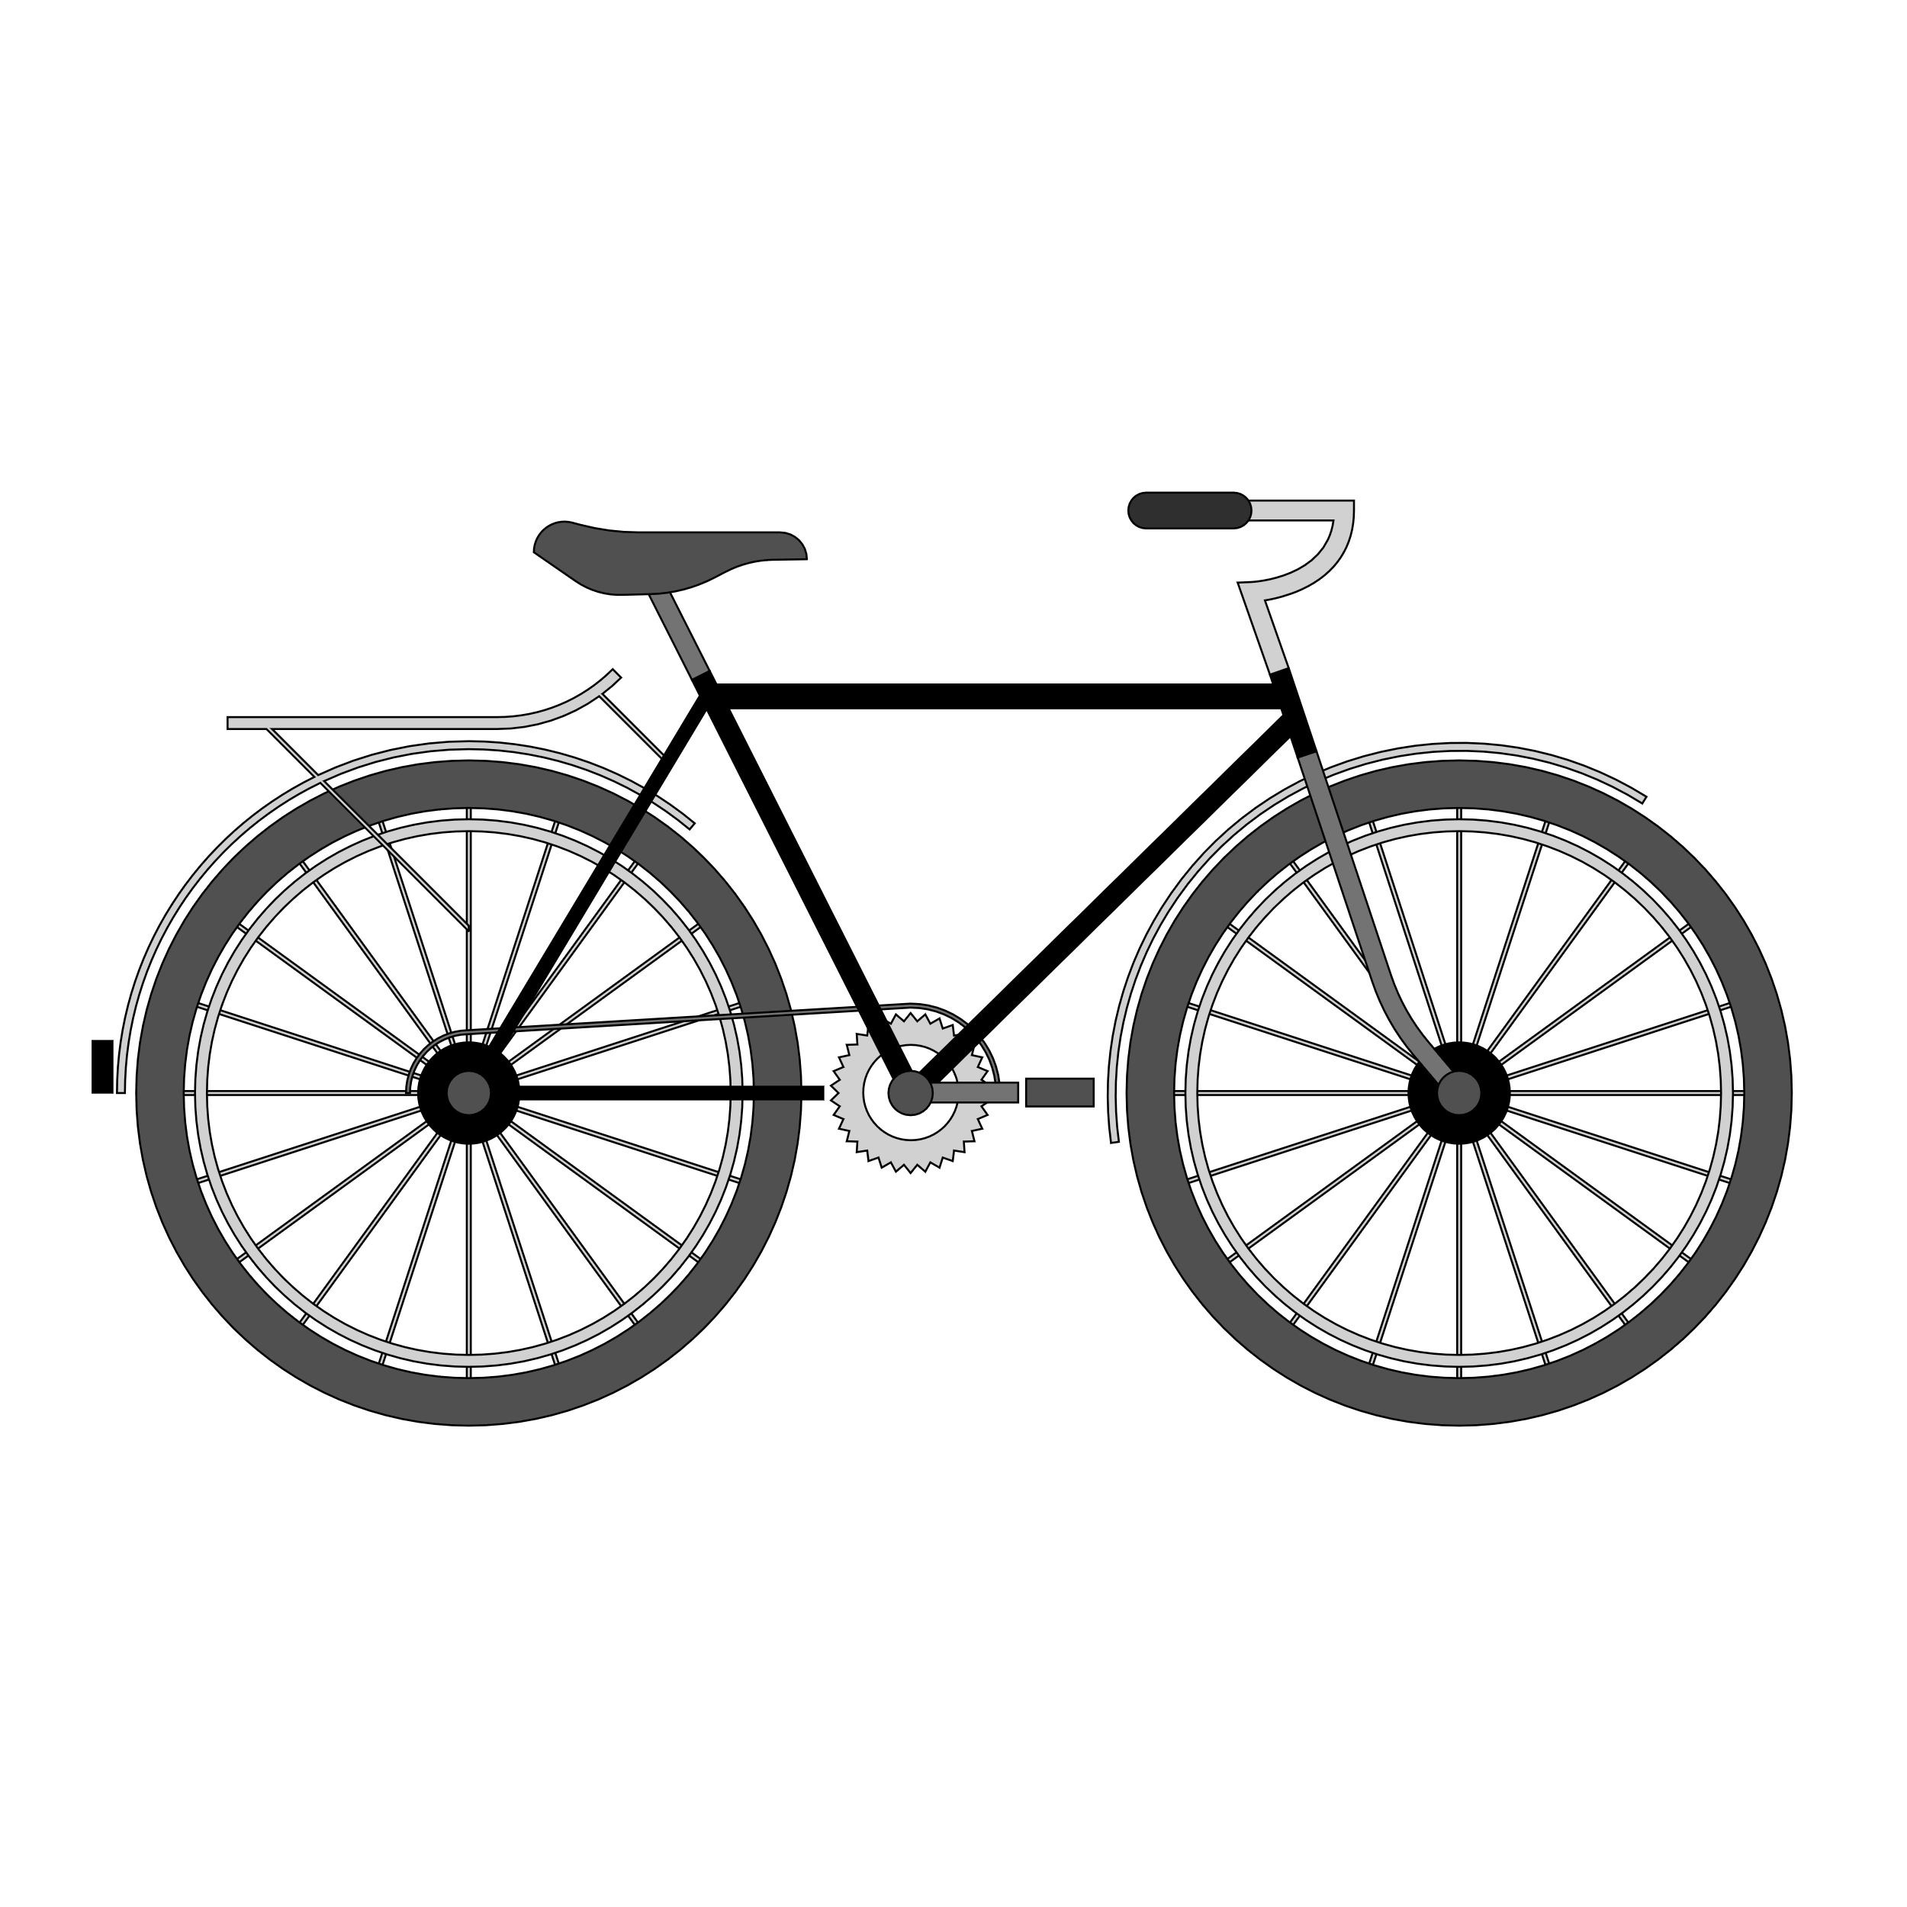
Adventure works project

Slide 2
ABOUT THE DATASET
Adventure Works Cycles, the company on which the Adventure Works sample databases are based, is a large, multinational manufacturing company. The company manufactures and sells metal and composite bicycles to North American, European and Asian commercial markets.
In 2000s, Adventure Works Cycles bought a small manufacturing plant in Mexico. Which manufactures several critical subcomponents for the Adventure Works Cycles product line. These subcomponents are shipped to the Bothell location for final product assembly. In 2001, this manufacturing plant became the sole manufacturer and distributor of the touring bicycle product group.
Coming off a successful fiscal year, Adventure Works Cycles is looking to broaden its market share by targeting their sales to their best customers, extending their product availability through an external Web site, and reducing their cost of sales through lower production costs.

Slide 3
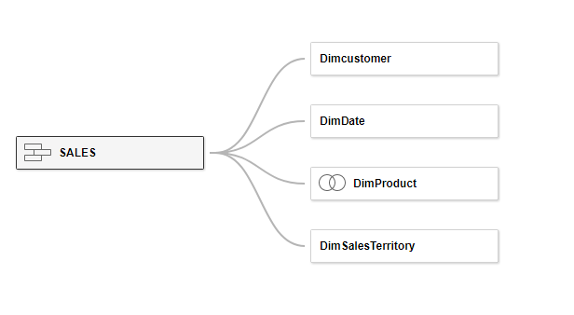
ABOUT THE DATASET

